Slide 1
C 프로그래밍 기말프젝 - Socket Programmig
Server-Client Chat Program
10206 김우진

Slide 2
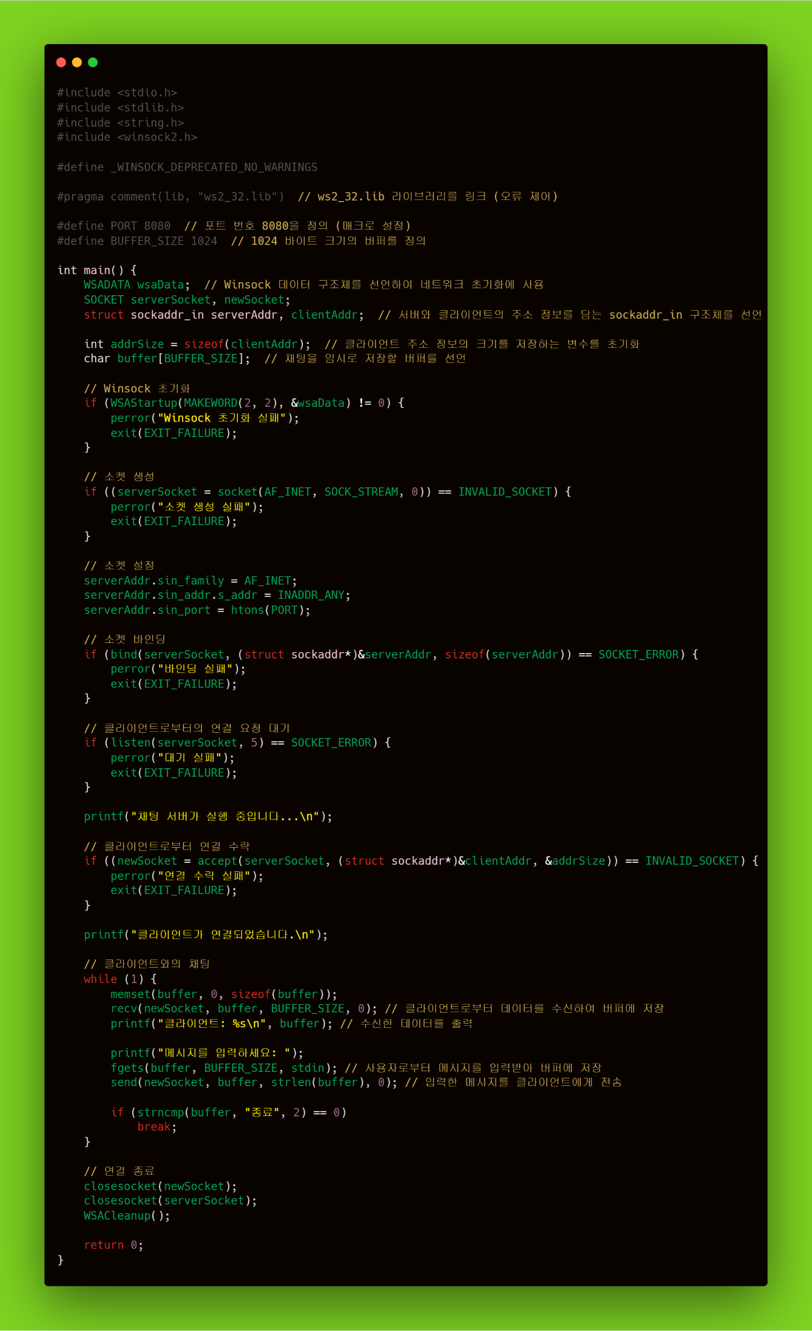
Server Code ->

Slide 3
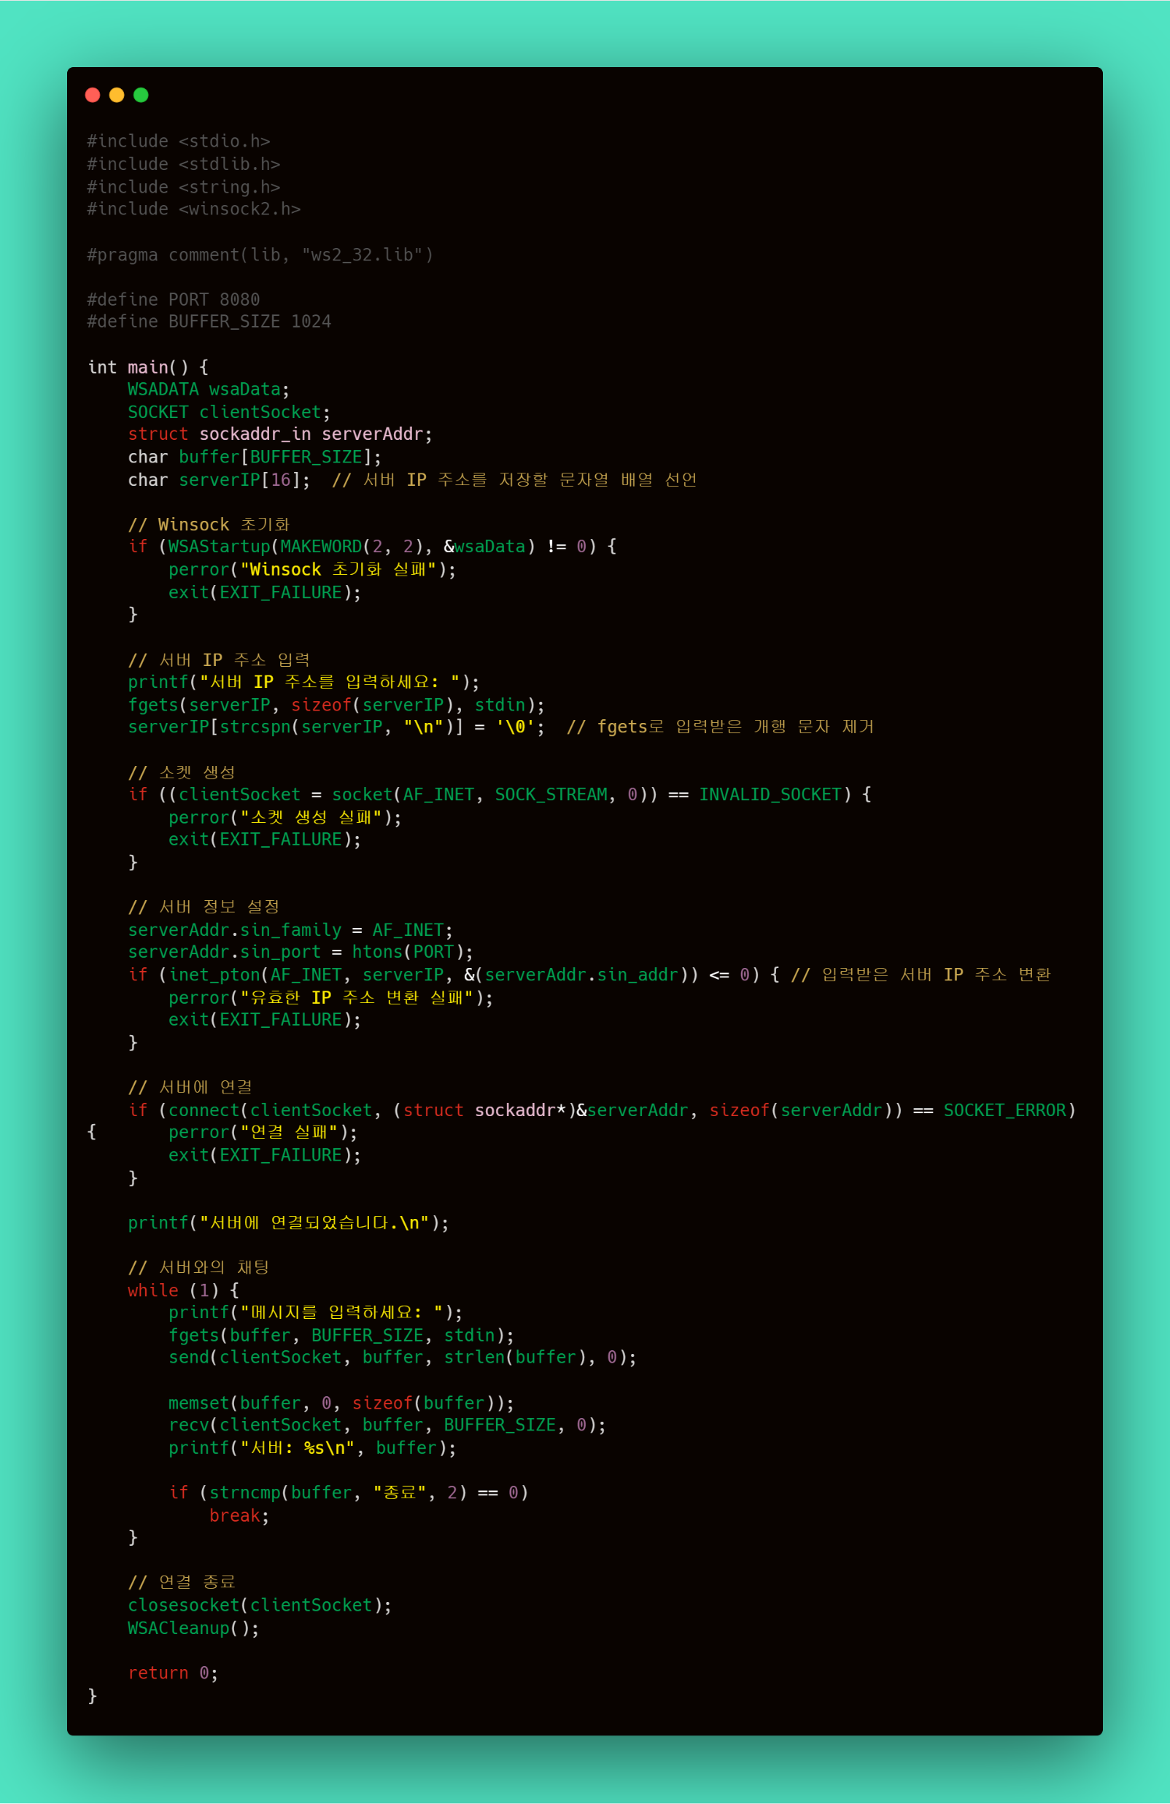
Client Code ->

Slide 4
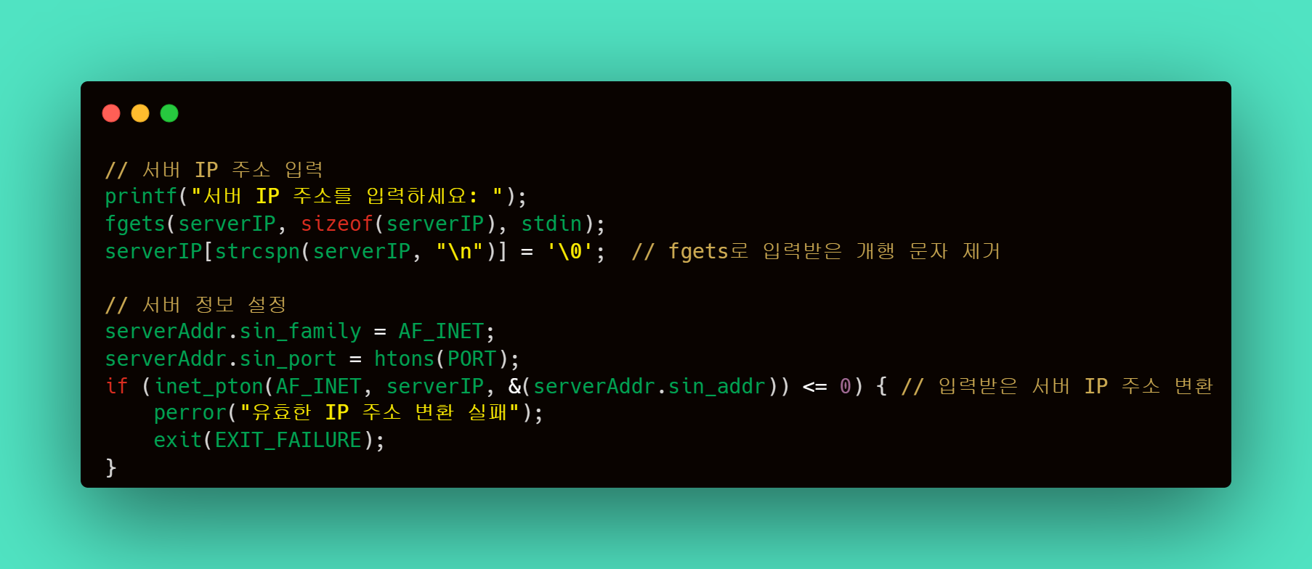
Client – Connecting(1)

Slide 5
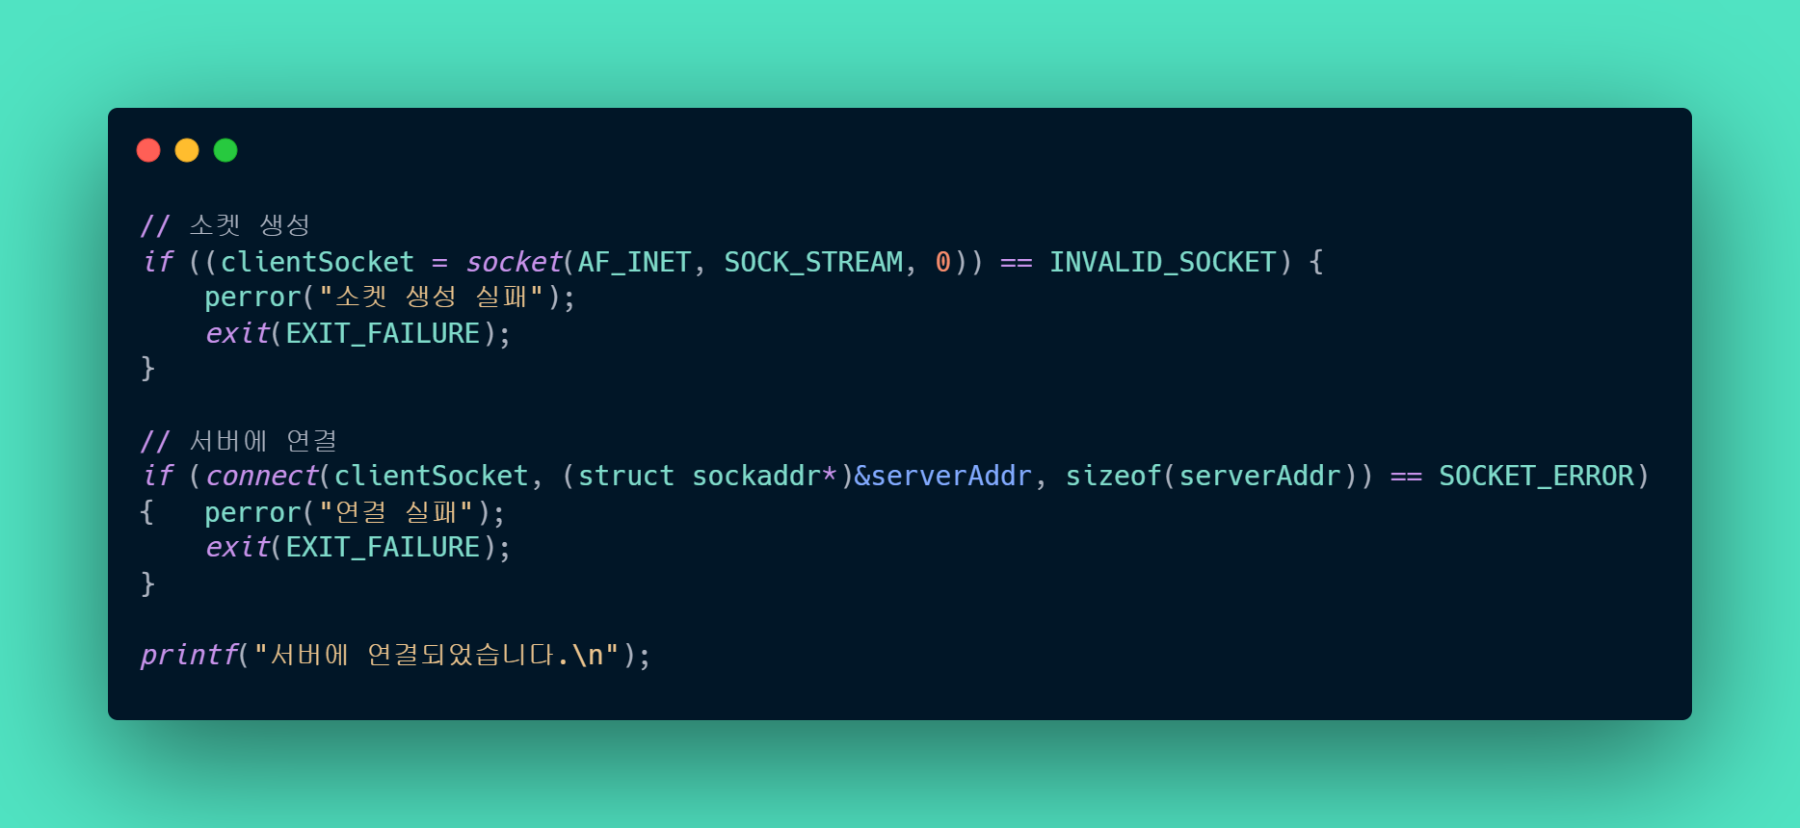
Client – Connecting (2)

Slide 6
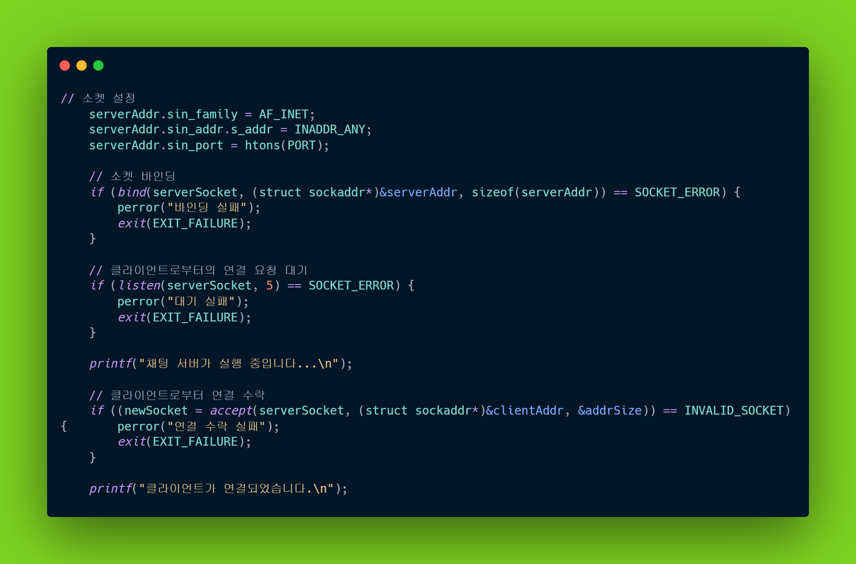
Server – Connecting

Slide 7
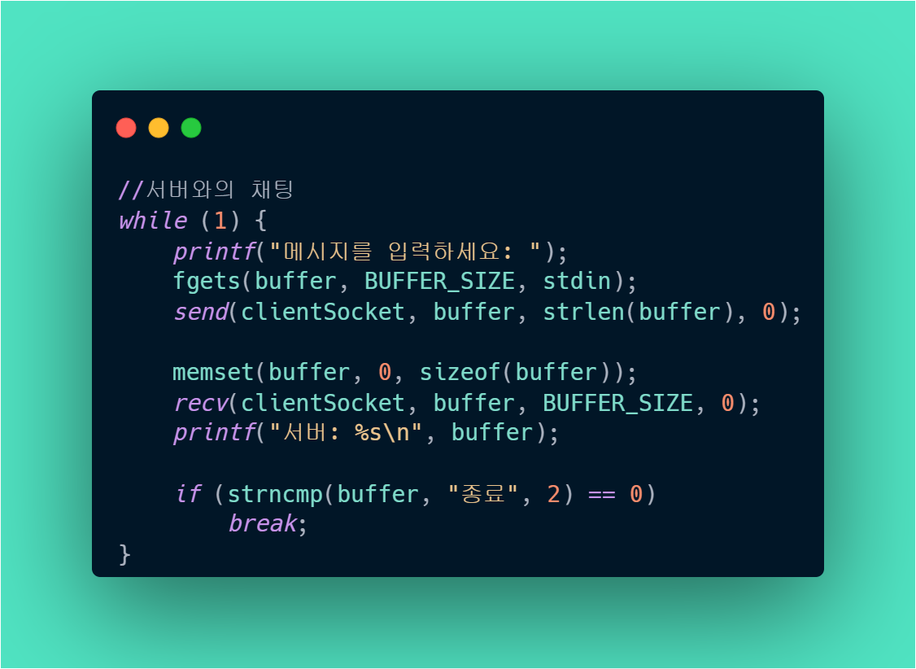
Client - Chatting

Slide 8
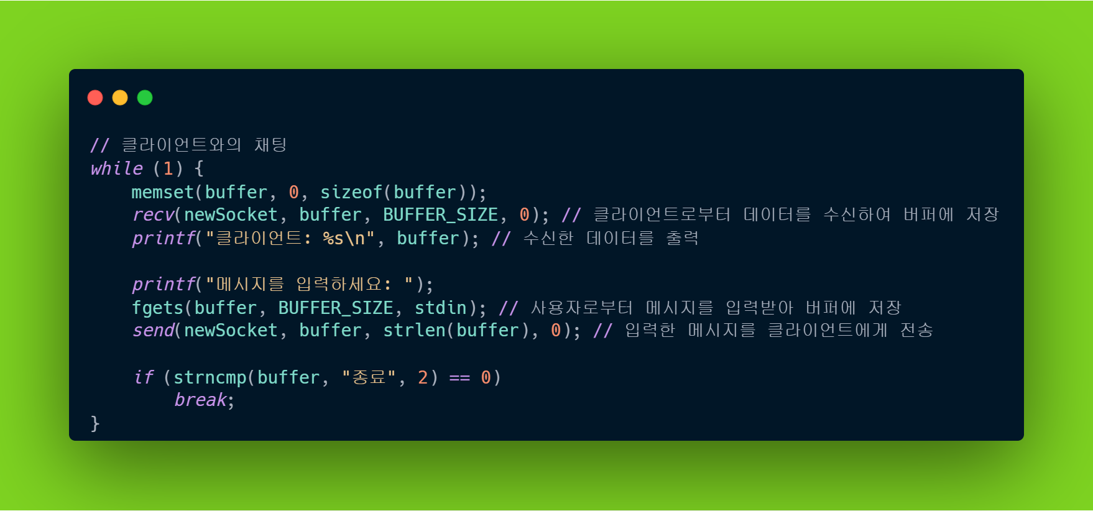
Server - Chatting

